Slide 1
Deep Learning APPLICATIONS In Medical Image Analysis
JOSE DIXON – CS470 – AI – FALL 2018
JUSTIN KER1, LIPO WANG 2, JAI RAO1, AND TCHOYOSON LIM3
1Department of Neurosurgery, National Neuroscience Institute, 308433 Singapore
2School of Electrical and Electronic Engineering, Nanyang Technological University, 639798 Singapore
3Department of Neuroradiology, National Neuroscience Institute, 308433 Singapore

Slide 2
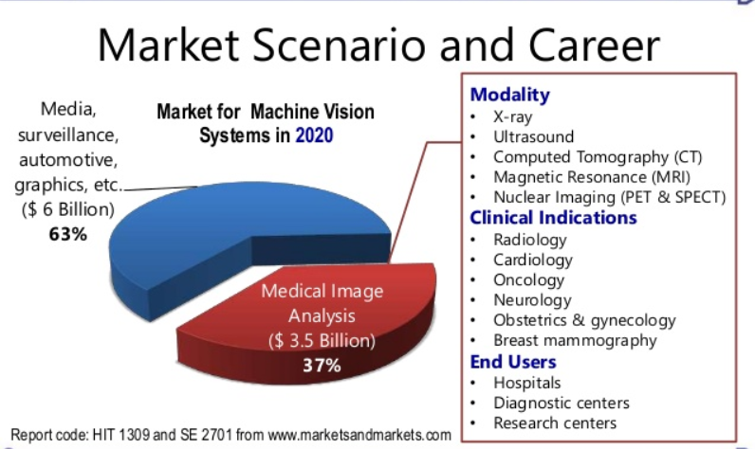
Purpose and Objective: Medical Image Analysis
Increased use of electronic records leads to Machine learning algorithms and image recognition tasks becoming more successful.
Machine learning can discover data algorithmically without laborious hand-crafting of features.
Machine learning algorithms can help improve effectiveness and aid in decision making for doctors, patients and physicians for medical imaging.
Medical image analysis is a key area in medical image computing and machine learning. Scientific methods are used for solving problems pertaining to images and their use for biomedical research and healthcare.

Slide 3
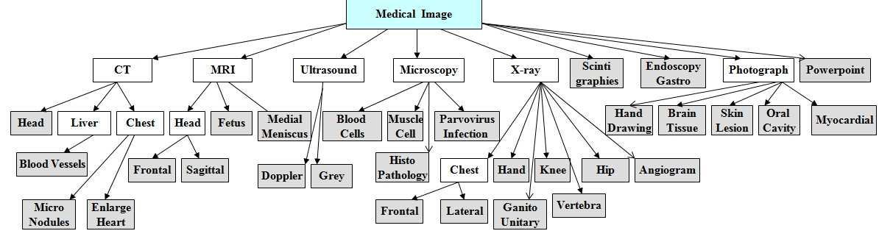
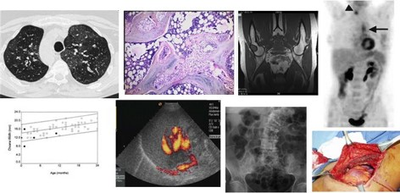
Types: Medical Imaging and Modalities
Some of these modalities examine multiple organs (such as CT, MRI) while others are organ speciﬁc (retinal photography, dermoscopy).
The amount of data generated from each study or image also varies.
A histology slide is an image ﬁle of a few megabytes while a single MRI may be a few hundred megabytes.

Slide 4
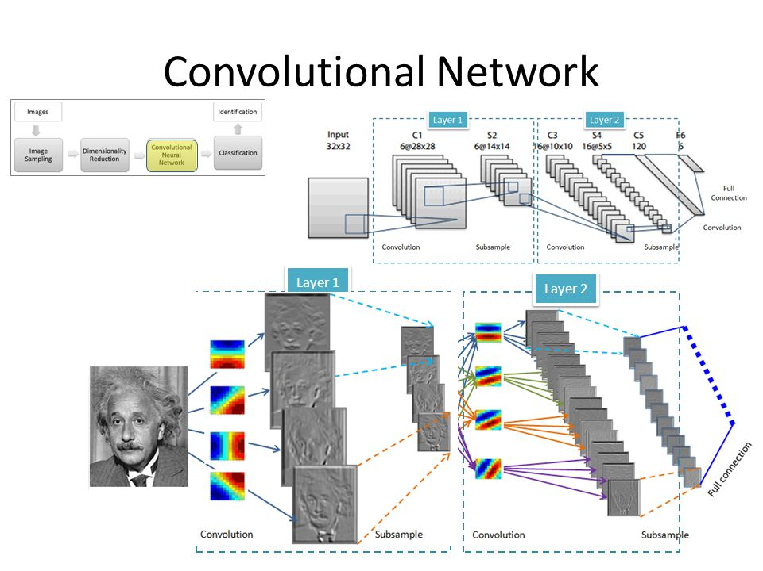
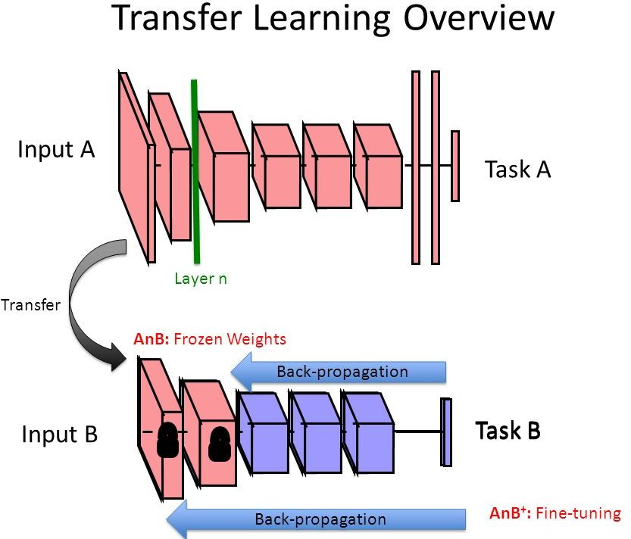
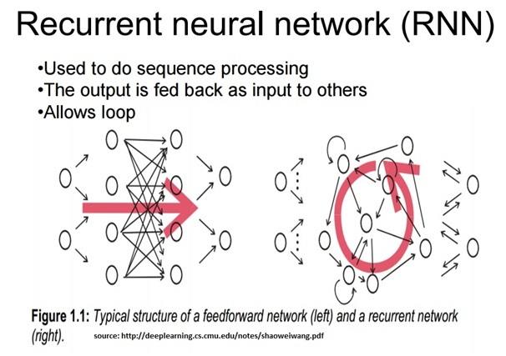
Supervised ML Architectures: CNNs, Transfer Learning, RNNs
Supervised learning = input variables (X) + an output variable (Y) + algorithm for mapping function from input to the output.
The goal is to approximate the mapping function so well for new input data (x) predicting output variables (Y)
Three supervised ML models:
Convolutional neural network: takes an input image of raw pixels, and transforms it via Convolutional Layers, Rectiﬁed Linear Unit (RELU) Layers, Pooling Layers, Fully Convolutional layers..
Transfer Learning with CNNs: is a machine learning method where a model developed for a task is reused as the starting point for a model on a second task.
Recurrent Neural Network: They are networks with loops in them, allowing information from the input to persist.

Slide 5
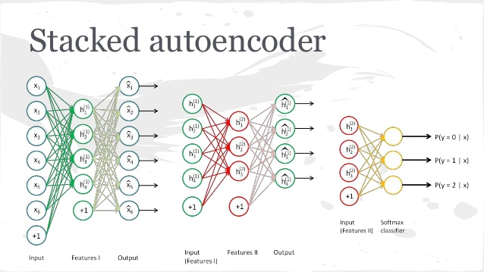
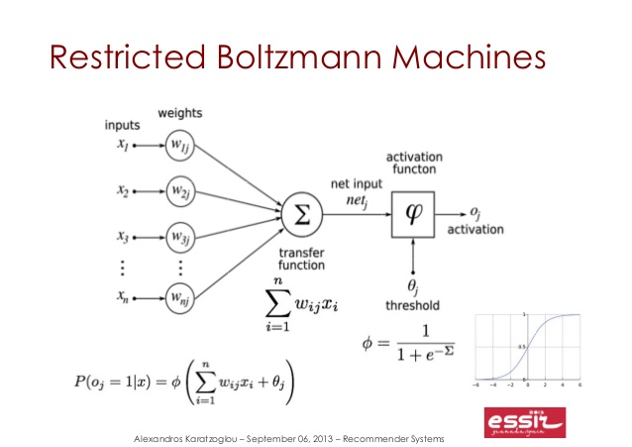
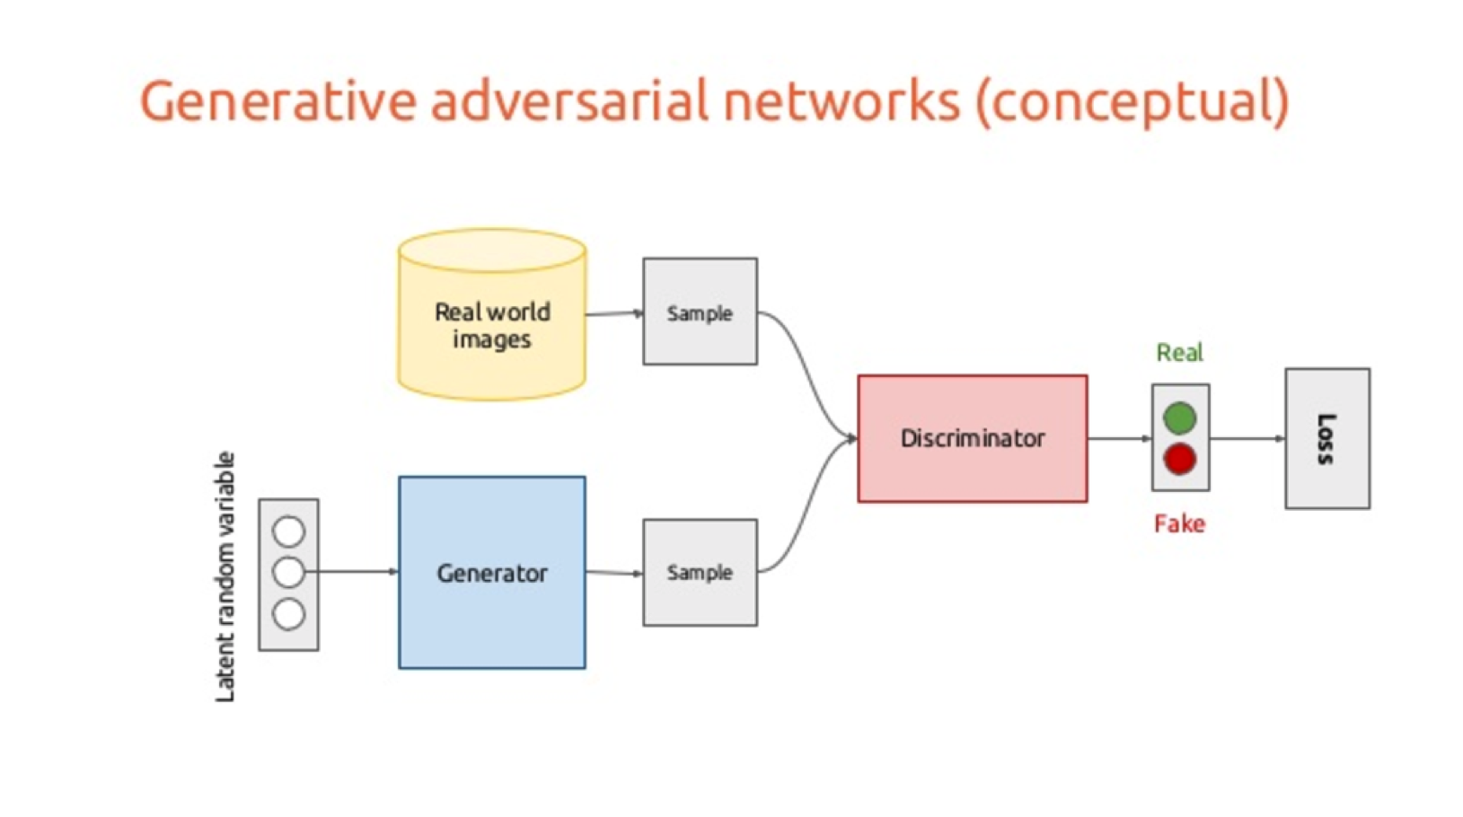
Unsupervised ML Architectures: Autoencoders, RBMs, GANs, and DBNs
Unsupervised learning is where you only have input data (X) and no corresponding output variables.
The goal for unsupervised learning is to model the underlying structure or distribution in the data in order to learn more about the data.
Three unsupervised ML models:
Autoencoders: learn feature representations of input data (called codings) in an unsupervised manner without labelled data—different types: Stacked, Denoising, Sparse, Variational.
Restricted Boltzmann Machines: is a generative stochastic artificial neural network that can learn a probability distribution over its set of inputs. Deep Belief Networks, variation of RBM--hidden layer output is input for the visible layer of a second RBM stacked on it.
Generative Adversarial Networks: comprise of two simultaneously-trained, competing models, which may be multilayer perceptrons such as CNNs.

Slide 6
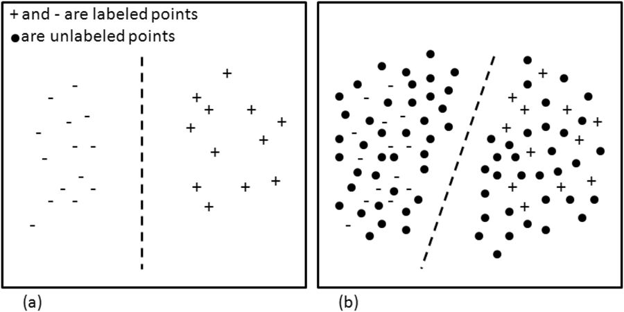
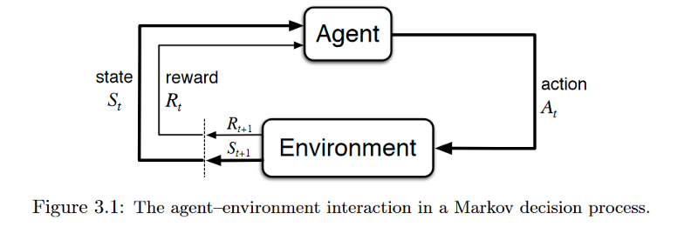
Other ML Architectures: Semi-supervised and Reinforcement ML Models
Semi-supervised ML: Problems where you have a large amount of input data (X) and only some of the data is labeled (Y) are called semi-supervised learning problems.
To make best guess predictions for the unlabeled data, feed that data back into the supervised learning algorithm as training data and use the model to make predictions on new unseen data.
Reinforcement learning: is the field that studies the problems and techniques that try to retro-feed it’s model in order to improve.
It actually relies on being able to monitor the response of the actions taken, and measure against a definition of a “reward”.

Slide 7
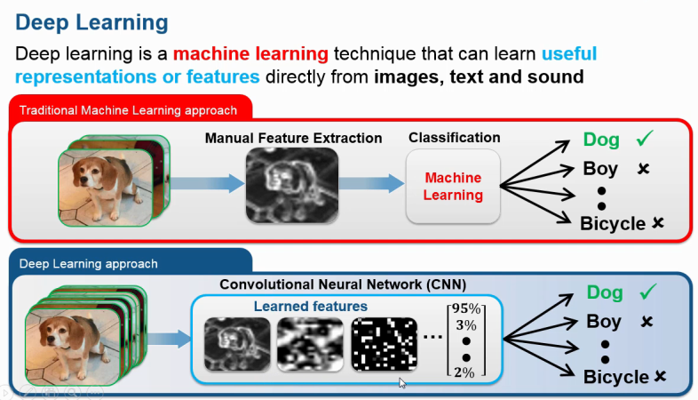
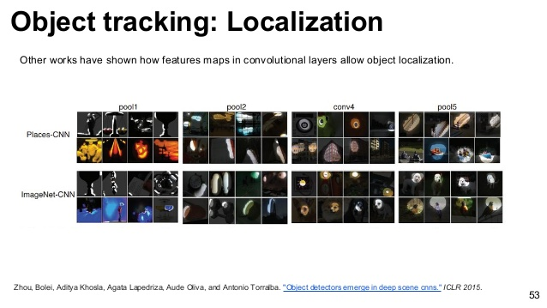
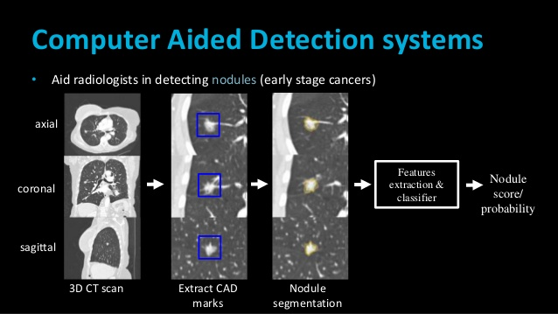
Applications in Medical Image Analysis: Classification, Localization, and Detection
First three applications in medical image analysis are:
Classification: Computer-aided diagnosis (CADx) is to improve the diagnostic accuracy and the consistency of the radiologists’ image interpretation and second opinion.
Localization: Object localization aims to locate and predict the main (or most visible) object in an image and tries to find out all the objects and their boundaries.
Detection: Computer aided detection (CADe) is a technology designed to decrease observational oversights—and thus the false negative rates—of physicians interpreting medical images.
Machine learning classifiers (Support Vector Machine, Random Forest) and feature extractors (Local Binary Patterns, Bag of Visual Words), convolutional neural networks (VGG, ResNet) are used possibly, with techniques such as data augmentation and stacked autoencoders.

Slide 8
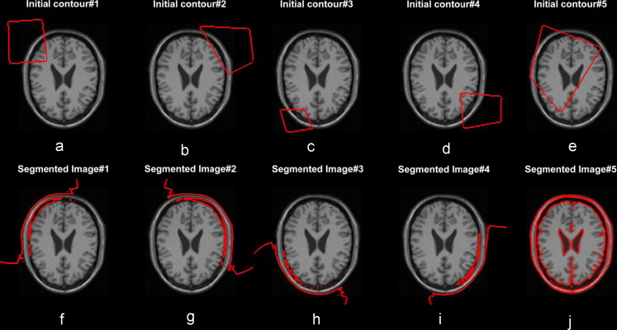
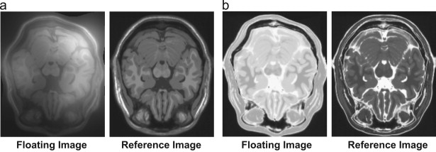
Applications in Medical Image Analysis: Segmentation and Registration
Last two applications in medical image analysis are:
Segmentation: Image Segmentation means creating parts of an image into segments which are conceptually meaningful or simple for further analysis. Usually we want to locate objects and boundaries in the images.
Registration: Image registration is the process of overlaying images (two or more) of the same scene taken at different times, from different viewpoints, and/or by different sensors.
This is relevant to two or three-dimensional convolutional neural network architectures and primarily used for CT and MRI scans.

Slide 9
Conclusion: Future Work and Challenges Medical Image Analysis
Challenges in medical image analysis:
Limit imposed by the lack of labelled datasets, which hampers training and task performance.
The lack of data is two-fold and more acute: there is general lack of publicly available data, and high-quality labelled data is even more scarce.
Data or class imbalance in the training set refers to the number of images in the training data being skewed towards normal and non-pathological images
Future work and research of medical image analysis include prognostication, content-based image retrieval, image report or caption generation, and manipulation of physical objects with LSTMs and reinforcement learning, involving surgical robots.

Slide 10
Closing Video
https://www.youtube.com/watc h?v=mvovHJDnDLA (Crtl+Click, Copy and Paste)

Slide 11
References
“A Gentle Introduction to Transfer Learning for Deep Learning.” Machine Learning Mastery, 21 Dec. 2017, machinelearningmastery.com/transfer-learning-for-deep-learning/.
Banerjee, Suvro. “An Introduction to Recurrent Neural Networks – Explore Artificial Intelligence – Medium.” Medium, Medium, 23 May 2018, medium.com/explore-artificial-intelligence/an-introduction-to-recurrent-neural-networks-72c97bf0912.
“Medical Image Analysis-The Wave of Future Diagnosis.” Edocscan.com, www.edocscan.com/medical-image-analysis.
Machado, Gustavo. “ML Basics: Supervised, Unsupervised and Reinforcement Learning.” Medium, Medium, 6 Oct. 2016, medium.com/@machadogj/ml-basics-supervised-unsupervised-and-reinforcement-learning-b18108487c5a.
“ML Wiki.” Cosine Similarity - ML Wiki, mlwiki.org/index.php/Semi-Supervised_Clustering.
Supervised and Unsupervised Machine Learning Algorithms.” Machine Learning Mastery, 22 Sept. 2016, machinelearningmastery.com/supervised-and-unsupervised-machine-learning-algorithms/.

